Slide 1

“SECOND PHASE PRESENTATION” BACHELOR OF ENGINEERING IN COMPUTER SCIENCE AND ENGINEERING
POLYRECYCLER BIN
RECYCLE AND EARN
UNDER THE GUIDANCE OF : PROF. CHITRASHREE.K
PROJECT TEAM:
ASHWINI.T FALAQ.K PRADNYA.P
TRUPTI.H TRUPTI.M

Slide 2
CONTENTS:
1.ABSTRACT
2.INTRODUCTION
3.LITERATURE SURVEY
4.EXISTING SYSTEM
5.PROPOSED SYSTEM
6.SYSTEM DESIGN
7.REQUIREMENT SPECIFICATIONS
8.SCREENSHOTS
9.CONCLUSION AND FUTURE ENHANCEMENT
10REFERENCES

Slide 3
ABSTRACT:
Due to increasing in amount of waste generated by human’s and limited landfill sites for dumpingwaste, recycling it is one of the novel approaches to manage the waste effectively.
To overcome such an issue, an automated recycle bin designed and installed in many countries with a reward featured is developed from a poly recycler concept.
This project explains the simulation of poly recycler Machine with fraud detection with Strain Gauge Weight Sensor, CapacitiveProximity Sensors and Infrared Photoelectric Sensor to detect fraud.
poly recycler Machine process by acceptingplastic items and gives coins as a reward according to the weight of plastic items. In this, poly recycler Machine supports only plastic items as an input, coins as an output. The poly recycler is simulated and implement using Xilinx in Verilog.

Slide 4
INTRODUCTION:
* Poly recycler is an efficient process and motivated way of collecting waste material. Poly recyclers are differentiated on the basis of supporting number of items as an input and output there . So, we planned to simulate the poly recycling machine on Xilinx along with Strain Gauge Weight Sensor,Capacitive Proximity Sensors and Infrared Photoelectric Sensor to detect fraud.
* The objective to simulate the Poly recycler is to effectively managing the waste for recycling purpose and decrease thelevel of pollution. In proposed Poly recycler, the user inserts plastic items into machine after thismachine start to work. In coming time, Reverse Vending Machine can be implement on subway

Slide 5
LITERATURE SURVEY:
After doing lots of literature study about poly recyclers we found that Razali Tomari implement the frame work for Standard Recycle Bin System. In which the process is developed on BinProcessing Unit(BPU) .
In one Patent author explain the method for detecting fraud attempts by describing the component used in poly recycling machine and also in vending machine .
Author explain the real time implementation of poly recycler at bigger level, where user enter in mart and mobilecode through messages.This code give guideline to user to finish the shopping.
Another approach is discussed in where machine which give token as output is monitored by a video surve illancecontext rather then depend on tracking output to reduce the error. In paper discuss about the wireless connection between machine and user mobile for mobile payment.

Slide 6
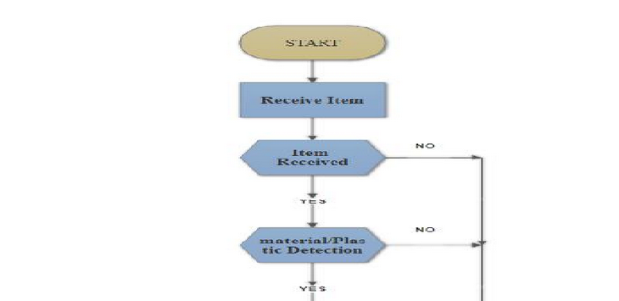
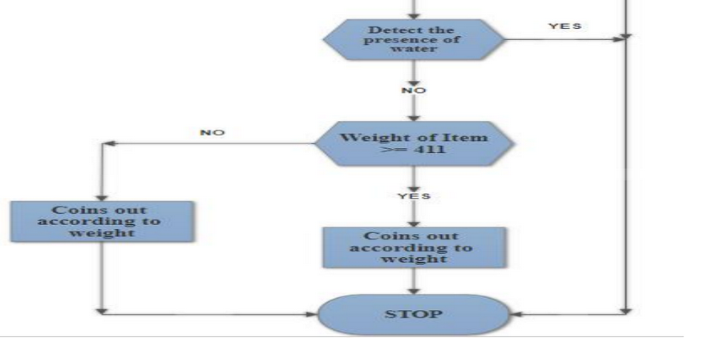
EXISTING SYSTEM:

Slide 7
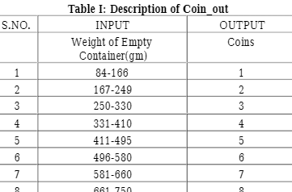
PROPOSED SYSTEM:
IMPLEMENTATION:
Project designed poly recycler in terms of state diagram. The user can get output in terms of coin that is depend on weight of the item received by machine. Description of output is explained properly in below table.

Slide 8
Description :
The output of coins according to weight is shown in figure .
Where St0 is the initial state, St1, St2, St3 areinput states and output states are St4, St5, St6, St7, St8, St9, St10 and St11.
The weight_rx signal means thewaste plastic material is received or not received by the poly recycler, if received than move for further tests. Cancel_1 is a button used to cancel the process at any stage or the no material is received or the item is not made up of plastic or item is filled with something.
Hence the process is cancel by machine by itsown [6]. There are two conditions one is when weight is less than 411gm then the poly recycler give coins (1,2,3,4) according to their weight and second is when weight is greater than 410gm then it willgive coins (5,6,7,8) as output and explained properly in below

Slide 9
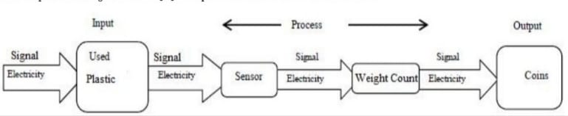
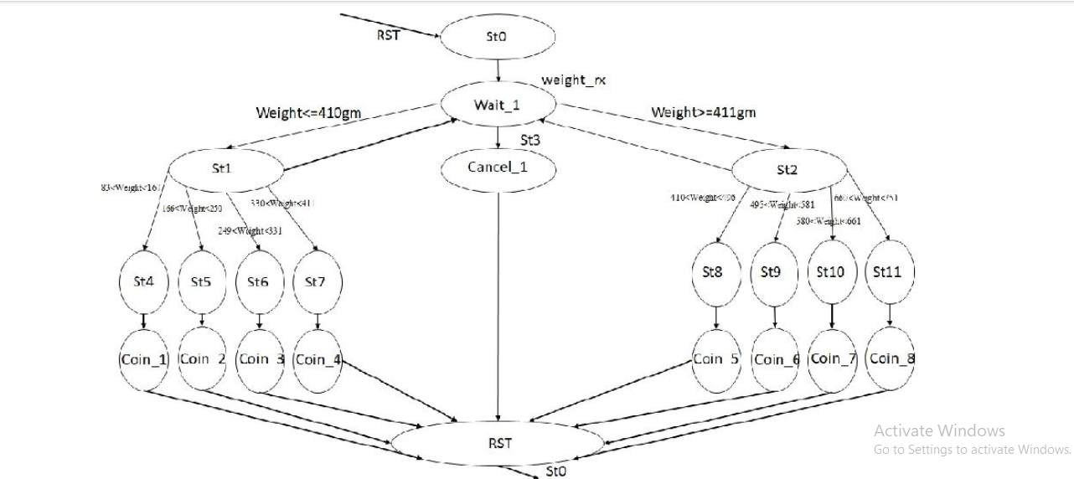
SYSTEM DESIGN:
1.Block diagram of poly recycler

Slide 10
REQUIREMENT SPECIFICATION:
SENSORS:
Capacitive Proximity Sensor: - This sensor is used for detection of metallic and non-metallic objects ( plastic, tin, Aluminum, wood, etc.). It uses the variation of Capacitance between object and sensor.
Infrared Photoelectric Sensor: - This sensor is used to detect the presence of non-ideal thing as an input i.e. water, non-water-based fluids, stones etc. This sensor uses standard visible LEDs that pass-through water and detect it using 1450nm wavelength.
* Strain Gauge Weight Sensor: - This sensor is used to determine the weight up to 1Kg of items. It is in the form of straight bar and translate Pressure or Force into an electrical signal.

Slide 11
SCREENSHOTS:

Slide 12
CONCLUSION AND FUTURE ENHANCEMENT:
In this project, a prototype of the Smart Plastic Recycle Machine is successfully simulated. User inputs plastic material into the system, the system enables the summation of points throughout the recycling process.
The reward coins and weight of plastic increment with every input to the system. If the user inputs an invalid object or invalid type item into the system, system cannot except the input material and reset the system.
The system will work efficiently and cost effective in implementing the design of creating the recycle machine’s programmable hardware-based detection system using a sensors The future scope of this proposed of this project is to implement whole system on hardware.
The challenges and scopes of this work are:
1) Improved detection accuracy of the sensor system
2) Sorting system for different materials
3) Redemption of reward points
4) Lower energy consumption

Slide 13
REFERENCES:
* Maofic Farhan Karin, Khandaker Sharif Noor, Hasan U. Zaman Department of Electrical & Computer EngineeringNorth South University “Hardware Based Design and Implementation of a Bottle Recycling Machine using FPGA”proceedings of 978-1-5090-1181-0/16/$31.00 ©2016 IEEE.
* Muhammad Ali Qureshi, Abdul Aziz & Hafiz Faiz Rasool “Design and Implementation of Automatic Ticket Systemusing Verilog HDL” proceedings of international conference on Information Technology, pp- 707-712 IPCSIT vol.17 (2011) © (2011) IACSIT Press, Singapore.
* Seyed Bahram Zahir Azami & Mohammad Tanabian “Automatic Mobile Payment on a non- Connected VendingMachine” proceedings of Canadian Conference on Electrical and Computer Engineering, May 2004, pp- 731-734 Niagara Falls, Ontario,Canada.
* K. Martinko, "Pay for your subway ride in Beijing by recycling a plastic bottle",TreeHugger, 2014. [Online].Available: http://www.treehugger.com/culture/pay-your-subway-ride-beijingrecycling- plastic-bottle.html.
[Accessed: 05-Jan-2016].

Slide 14

THANK YOU

